Slide 1
CS61BL – Tutoring Section 12
Slides by Kevin Miao (kevinmiao@berkeley.edu)
Sorting
Review
Quiz Review (Optional)
Worksheet (20 min)
Questions (5 min)
Friendly reminder: Please participate in order to get marked as ‘present’
Resources:
www.cs61bl.org/su20/resources

Slide 2
Comparison Based Sorts
Idea: Comparing items with each other to determine the sorted order.
Stability: What if two items are equal() to each other?
  Example: [‘ex’, ‘in’]
  Equal() returns whether the strings are equal in length (in this example only)
  A stable sort will always return [‘ex’, ‘in’]
  Unstable sort could return either [‘ex’, ‘in’] or [‘in’, ‘ex’]

Slide 3
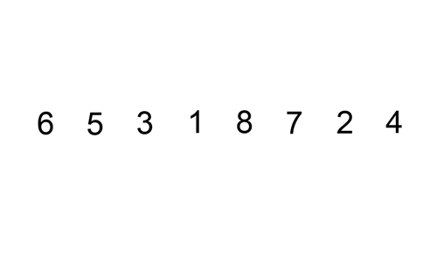
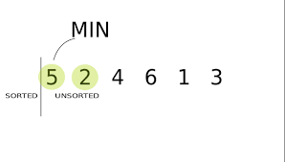
Comparison Based Sorts
Insertion Sort
  Algorithm: Loop over all items in your list. For each item, insert item in the right position in the sorted list
  Runtime:
    Best Case (Sorted Array): Θ(n)
    Worst Case (Reversely Sorted Array): Θ(n²)
  Stable: Yes
  Possible adjustments:
    Tree Sort
      Use a binary search tree to sort the sorted array
      Runtime will become O(nlog(n)) (Unbalanced Tree ➔ Θ(n²))
Selection Sort
  Algorithm: For each position, pick the minimum value on the right side.
  Runtime (Best/Worst):Θ(n²)
  Stable: No

Slide 4
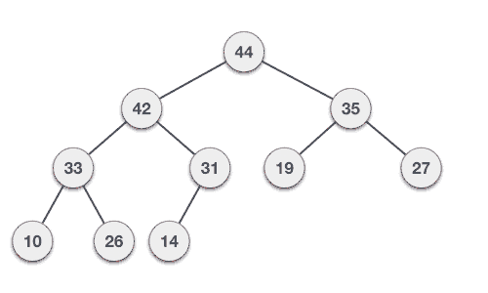
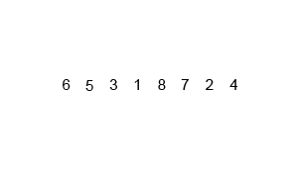
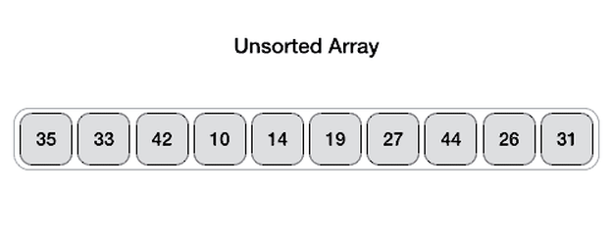
Comparison Based Sorts
Heap sort
  Algorithm: Basically throw all elements in a heap to be sorted.
  Runtime (Best/Worst): Θ(nlog(n))
  Stable: No
Merge Sort
  Algorithm: Divide by half recursively and then build up again but sorted
  Runtime (Best/Worst): Θ(nlog(n))
  Stable: Yes
Quick Sort
  Algorithm: Pick a pivot, sort elements smaller to the left and larger to the right. Recurse down in both halves.
  Runtime
    Best Case (Good pivot): Θ(log(n))
    Worst Case (Bad pivot): Θ(n²)
  Stable: Depends (Three way: stable)

Slide 5
Counting Based Sorting
The fastest we can do with Comparisons is O(nLog(n))
Counting Sort
  Iterate over collection and count occurences
  Then initialize new array with indices based on the counts
  Runtime: O(N+R)
    N = number of items
    R = number of distinct groups

Slide 6
Counting Based Sorting
Sort based on the most/least significant digit
LSD Radix
  Sort starting on the last digit to the most significant digit
  Runtime: O(D(N+K))
    D = max number of digits
    N = number of items
    K = number of possible digits
MSD Radix
  Sort starting on the last digit to the most significant digit
  Runtime Best Case: O(N+K)
    100, 999, 200, 320 (Radix 100 (3 passes) vs Radix 1000 (1 pass))
  Runtime Worst Case: O(D(N+K))
O(D(N+K)) ~ O(N) (for some b)
  D = O(b/log(n))
  K = O(N)

Slide 7
Quiz Q1

Slide 8
Quiz Q2

Slide 9
Worksheet

Slide 10
Worksheet

Slide 11
Worksheet

Slide 12
Worksheet

Slide 13

ALMOST DONE
Thank you.
(If you see me in person, say hi! Let’s not act like strangers!)
🎉

